Slide 1



PEILab Group Meeting
Leader: Zicong Hong
Team Member: Jian Lin, Haodong Wang, Qianli Liu, Kaibin Guo, Junjie Liu

Slide 2

VoCo-LLaMA

Slide 3
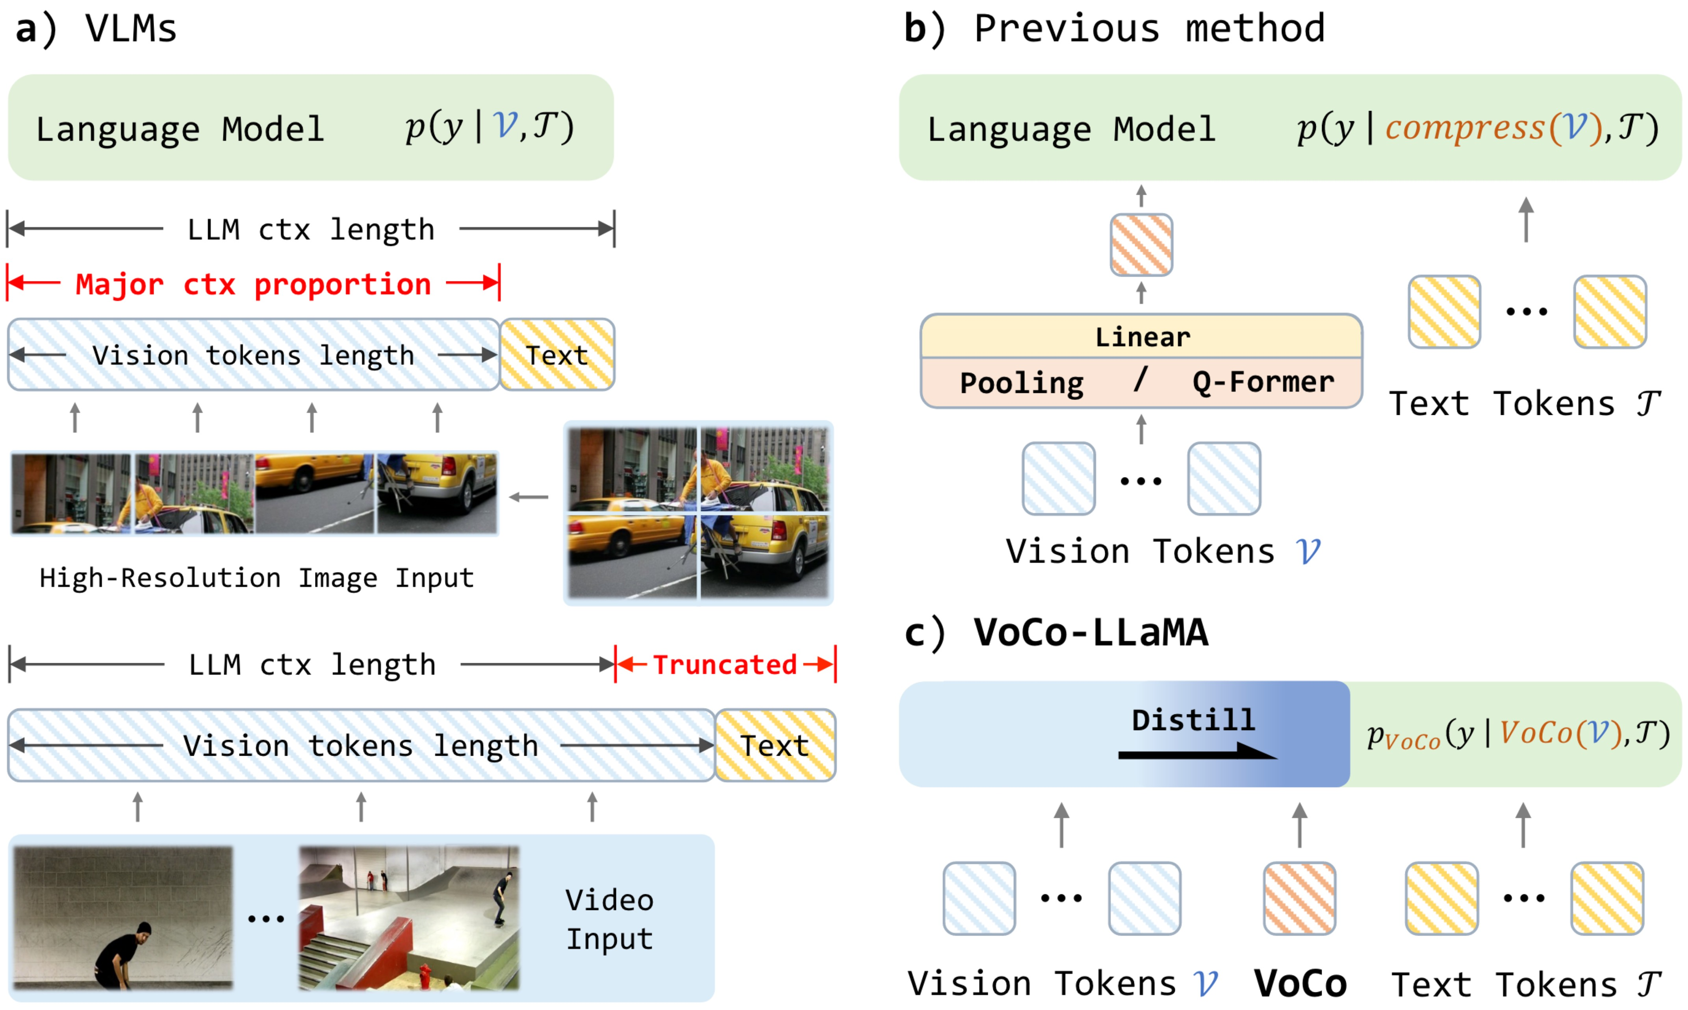
VoCo-LLaMA

Slide 4
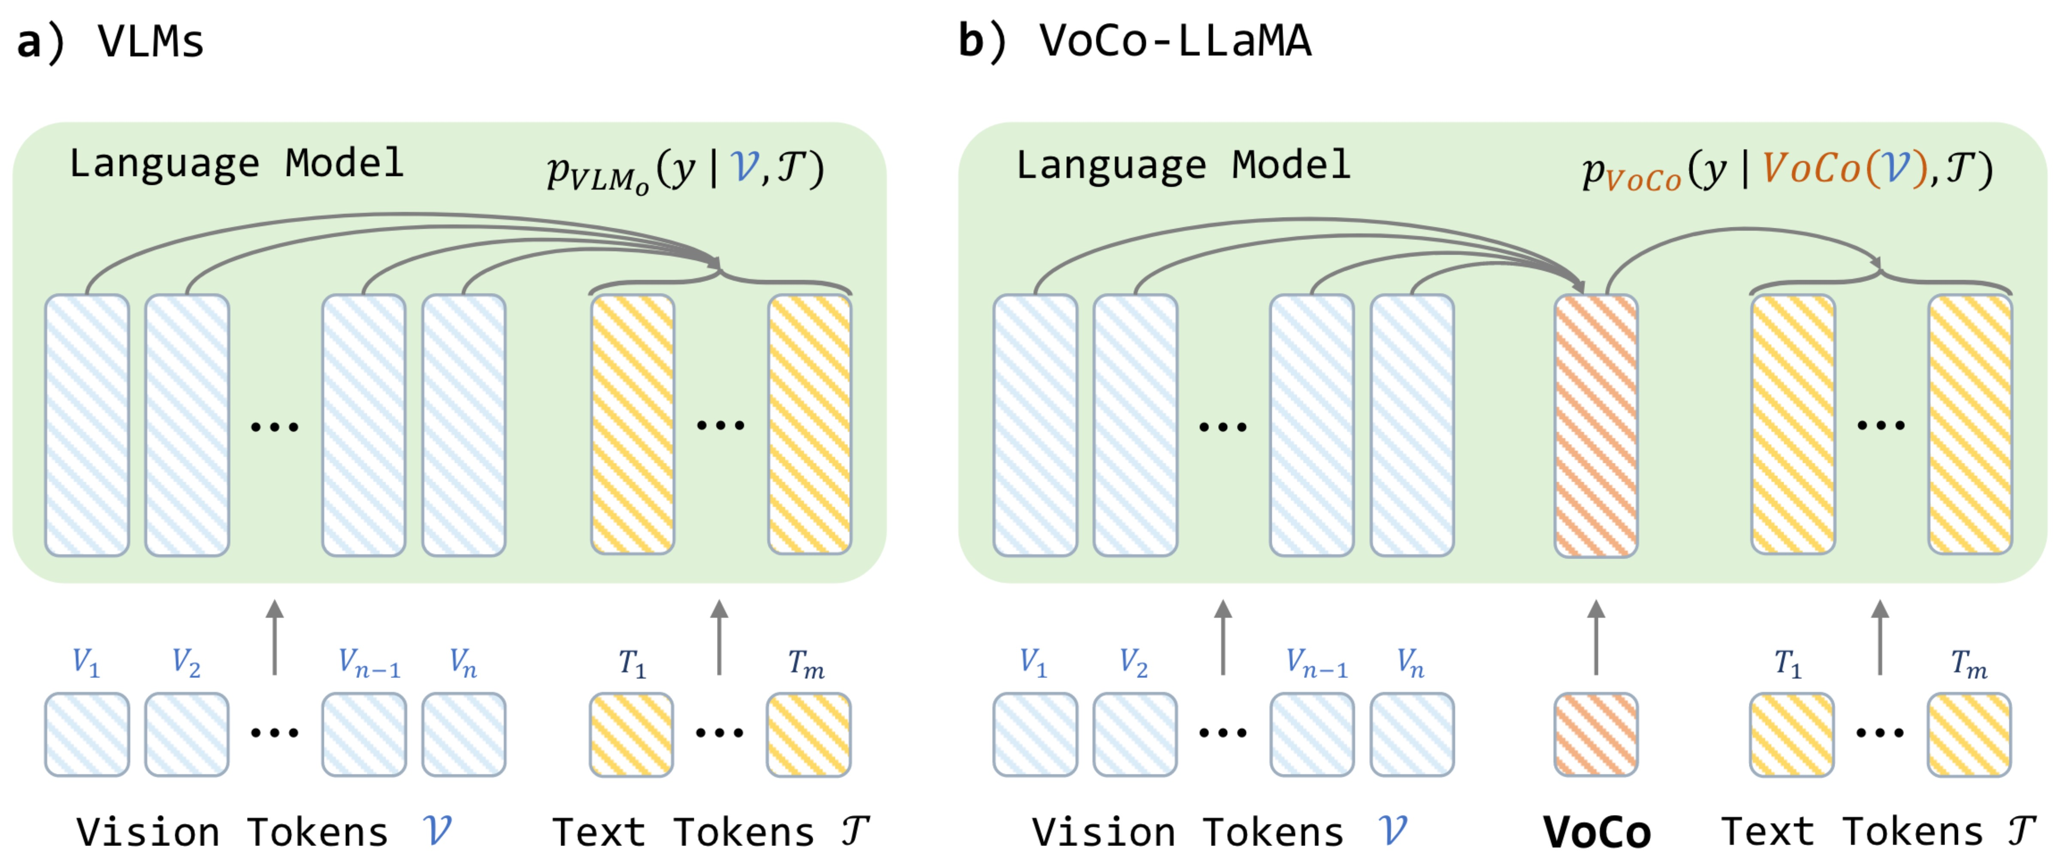
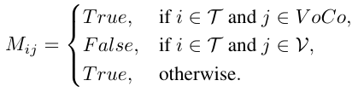

VoCo-LLaMA
attention mask:
loss function:

Slide 5
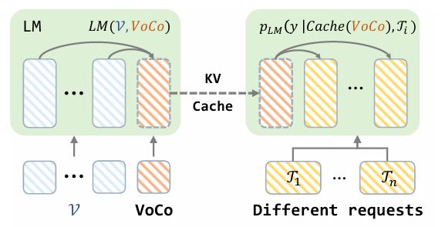
VoCo-LLaMA
Reuse of VoCo Cache

Slide 6
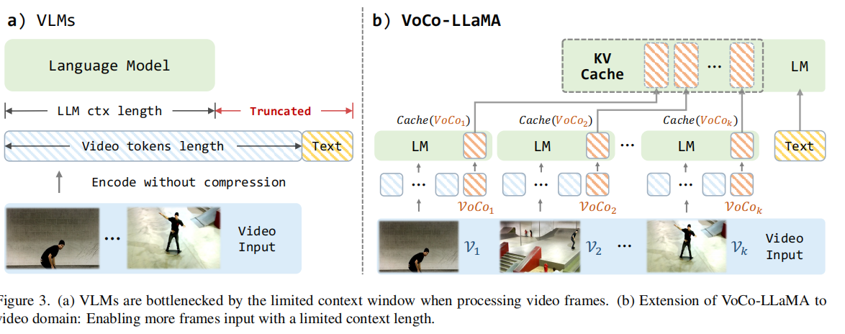
VoCo-LLaMA

Slide 7
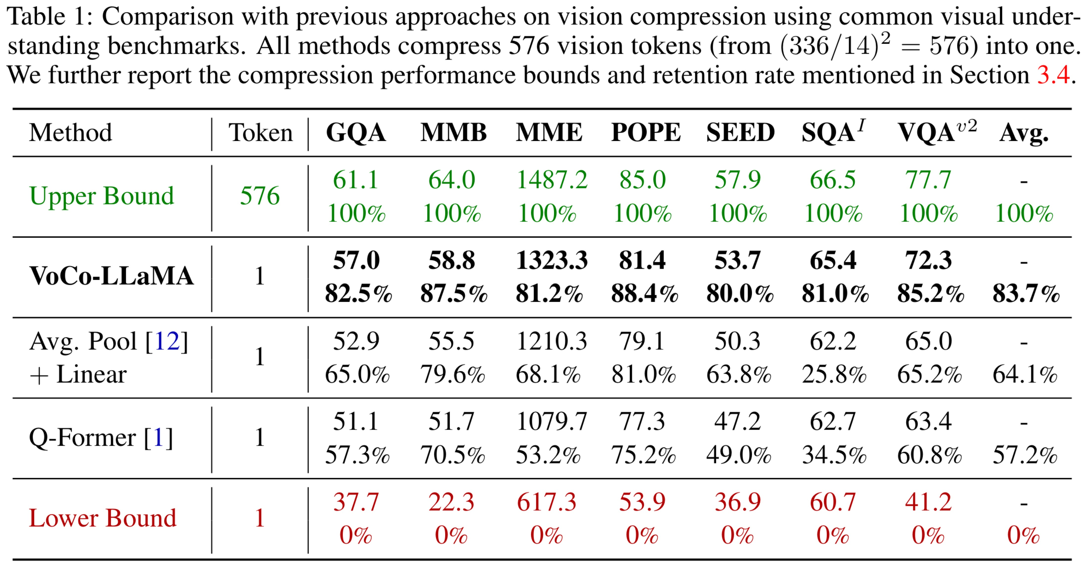
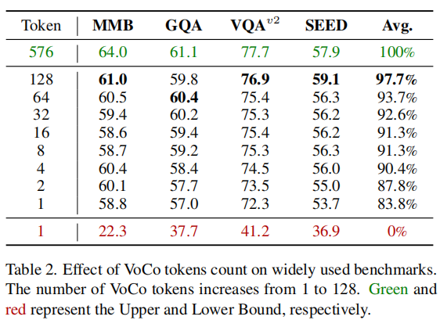
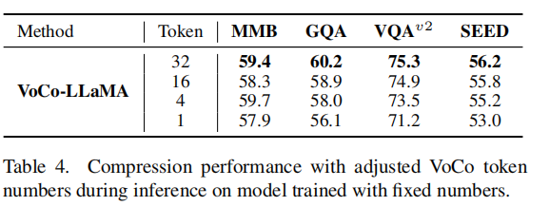
VoCo-LLaMA

Slide 8
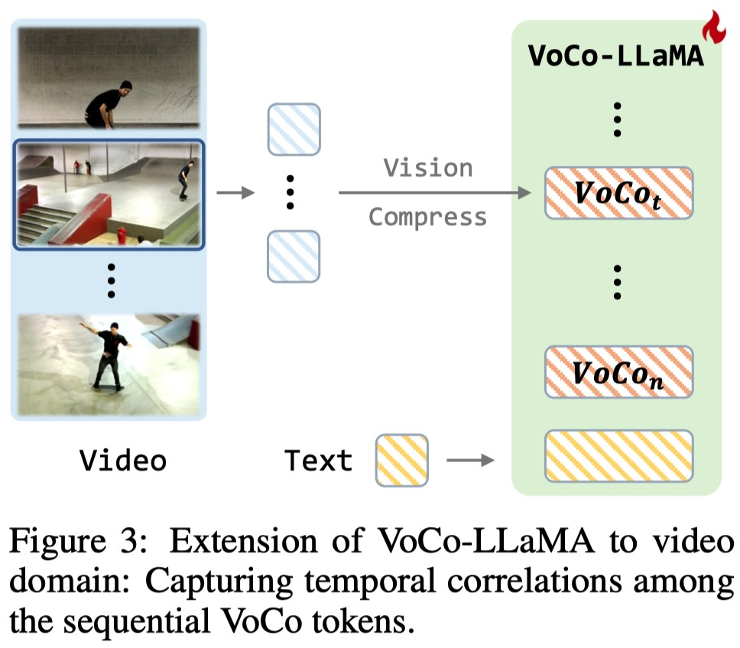
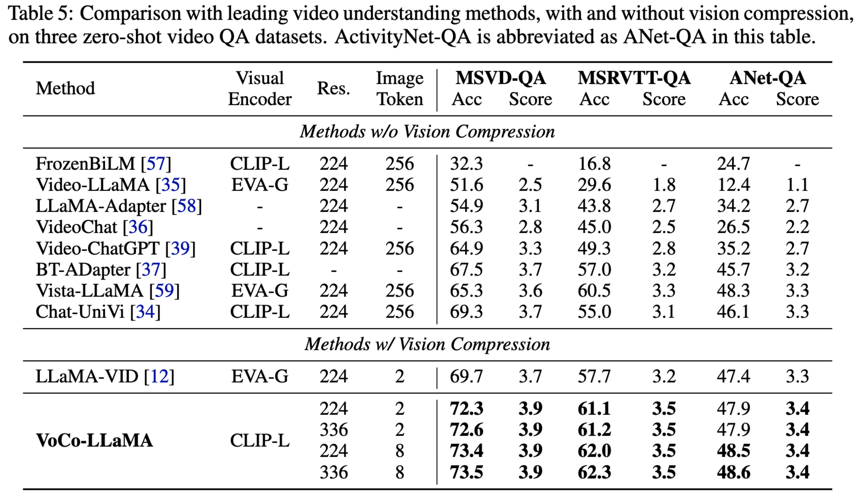
VoCo-LLaMA

